Slide 1

E-Commerce
Shaik Samiya Shireen
09/12/2024

Slide 2
Agenda
Problem Statement
Key Metrics
Total Sales by Product Category
Unique Customers by Year
Total Sales by Product
Average of Wait times by Delivery Type
Revenue Distribution
Monthly Sales: Current Year vs Previous Year
Reports

Slide 3
Problem Statement
You are working as a business analyst at Amazon, a company currently performing well. The stakeholders wish to maintain this level of performance and seek improvement. For this purpose, they want to devise new strategies.
You are part of a team exploring new ways to benefit customers, such as offering more discounts and Prime membership perks. Could you suggest additional methods to identify and reward customers and enhance their shopping experience?

Slide 4
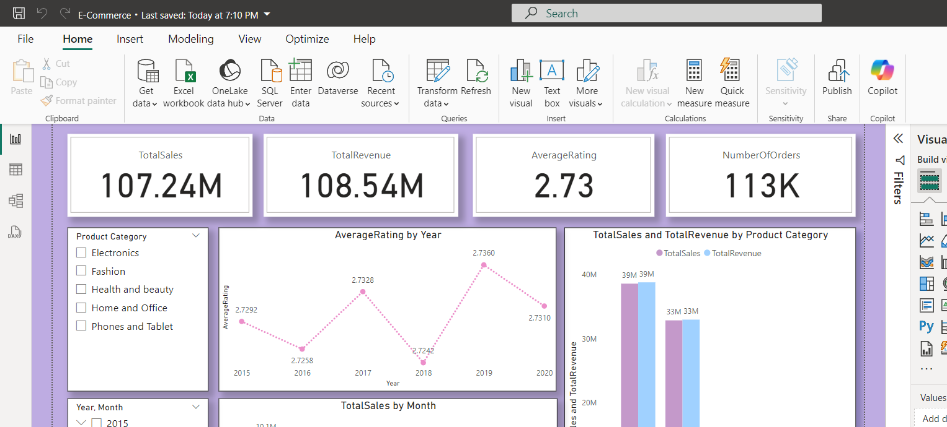
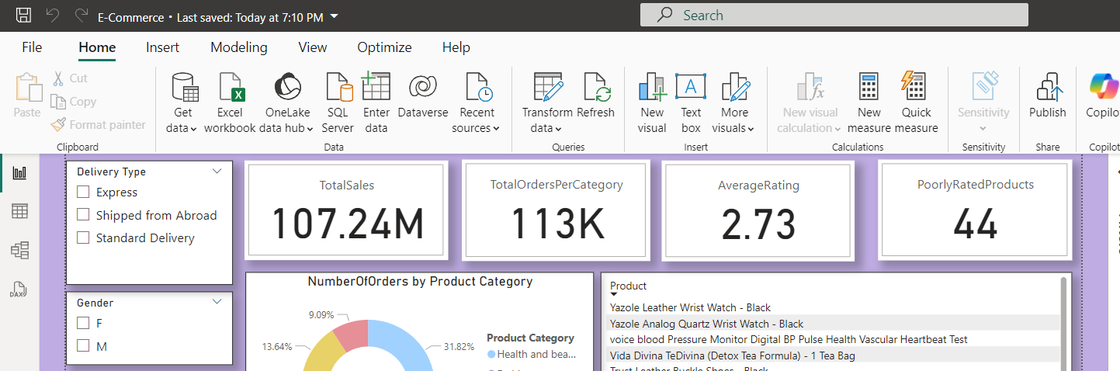
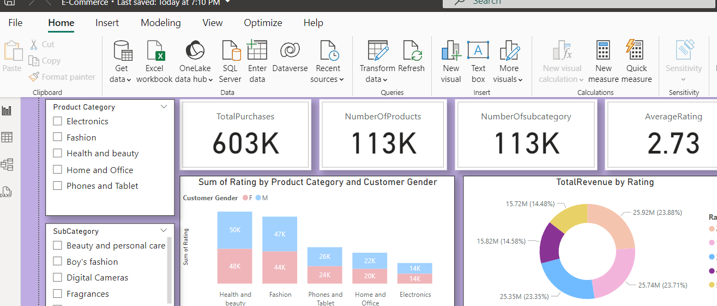
Key Metrics

Slide 5
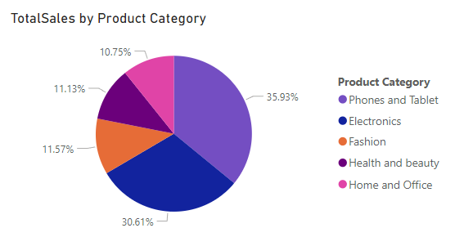
Total Sales by Product Category
Phones and Tablet(36%) and Electronics(30.6%) are top selling product categories. This indicates that marketing campaigns targeting this category can lead to further sales growth.
Fashion(11.57%) and Health and beauty(11.13%) show moderate sales. These categories have potential for growth by expanding product lines or launching targeted campaigns.
Home and Office products account for 10.75%, indicating lowest among the categories, where it still represents a substantial market.

Slide 6
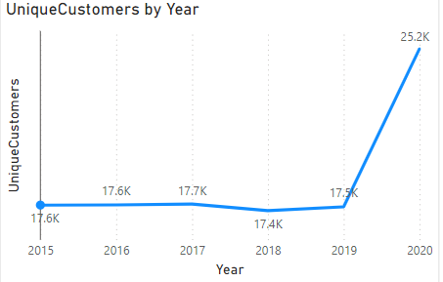
Unique Customers by Year
From 2015 to 2019, the number of unique customers remained relatively stable, fluctuating between 17,400 to 17,700. This suggests that the customer base has remained consistent year over year during this period.
There is a notable increase to 25,200 unique customers in 2020. This suggests a strong increase in customer acquisition.

Slide 7
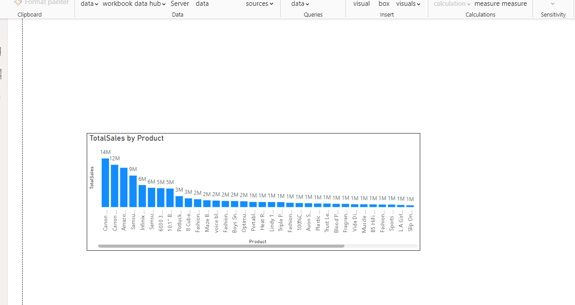
Total Sales by Product
Canon EOS 600D and Canon EOS 60D DSLR cameras are the highest-selling products, indicating high demand for quality photography equipment.
The Amazon Fire HD 8 Kids Tablet and Samsung Galaxy A02 smartphone show strong sales, that reflects customer interest in family-friendly and affordable devices.
Products with sales amounts closer to 1M or 2M may be more focused but still have potential for growth. These products can be used as tailoring marketing strategies or expanding the product line which helps to increase their visibility and sales.

Slide 8
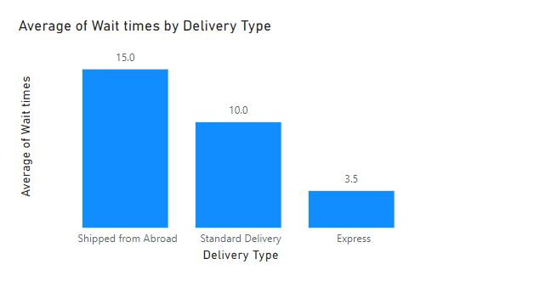
Average of Wait times by Delivery Type
There is a correlation between average wait times and delivery type between ordering and receiving a product.
This data highlights significant differences in wait times across delivery methods: Shipped from Abroad (15.0) has the longest delivery times, while Express Delivery (3.5) offers the fastest service.

Slide 9
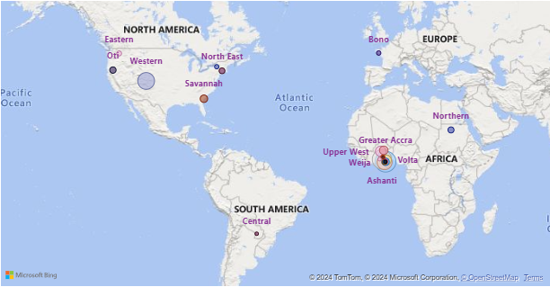
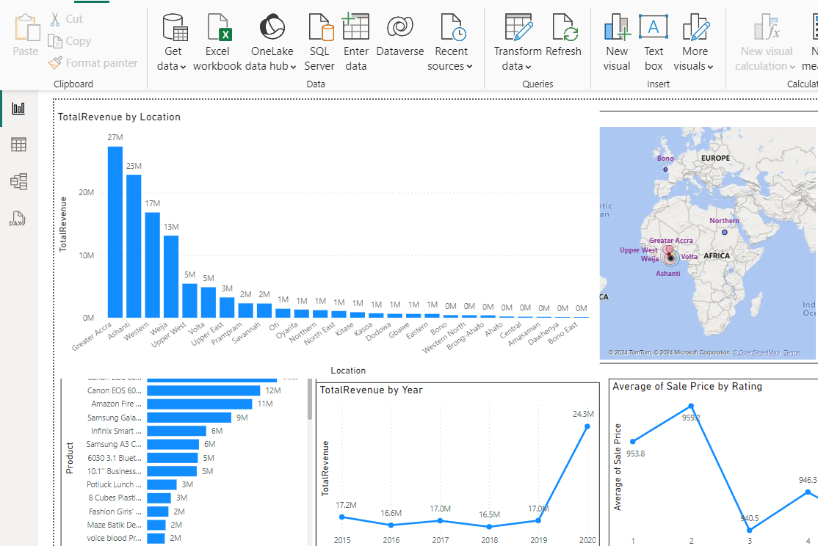
Revenue Distribution
Greater Accra, Ashanti and Western regions have high demand for products, making a key for marketing and business expansion.
Prampram, Savannah, or North East, there are opportunities to increase market share by tailoring strategies to local demands and promoting products more effectively.
Amasaman, Bono East and Dawhenya regions have lower sales, indicating smaller populations or be less commercially developed compared to higher-performing regions.

Slide 10
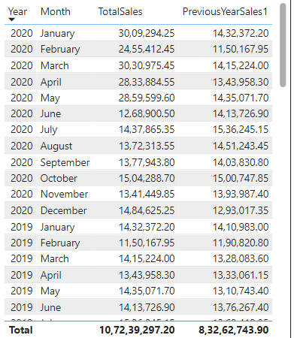
Monthly Sales: Current Year vs Previous Year
The early months of 2020 showed strong sales growth, which could be due to factors like seasonal trends, new product launches have led to increased demand for certain products.
February show lower sales, suggests that benefit from targeted promotions.
Months like May and October show strong performance, indicating potential high demand periods.
July and March have higher sales, due to focusing on promotions or adjusting marketing efforts to counter such declines in the future.

Slide 11
Recommendations
Market Segmentation Analysis: Utilize customer demographic data such as age, gender, and location to perform market segmentation analysis, enabling targeted marketing strategies to specific customer segments and geographic regions.
Reduce Waiting time: Improve customer satisfaction by focusing on reducing waiting times, particularly for products shipped from abroad.
Regular Performance Evaluation: Conduct periodic reviews of delivery performance metrics, including delivery times, accuracy, and customer feedback, to identify areas for improvement.
Customer Loyalty Program Design: Design and implement a customer loyalty program based on customer purchase behavior, frequency, and spending patterns, offering personalized incentives, rewards, and exclusive benefits to drive customer retention and loyalty.
Promotional Strategy Optimization: Analyze sales data to identify seasonal trends, peak demand periods, underperforming months, and marketing campaigns to boost sales during strategic timeframes.

Slide 12
Reports

Slide 13
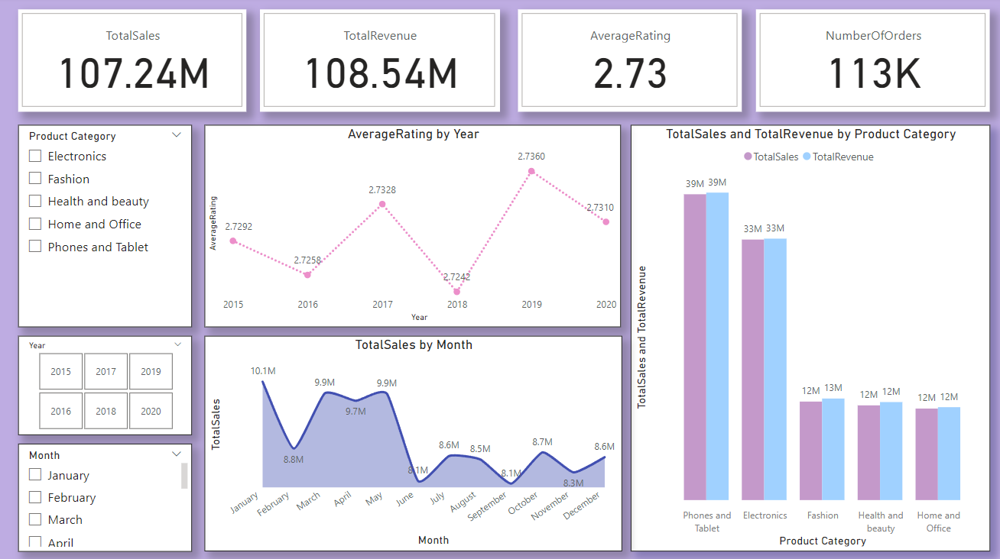
Amazon Sales Analysis

Slide 14
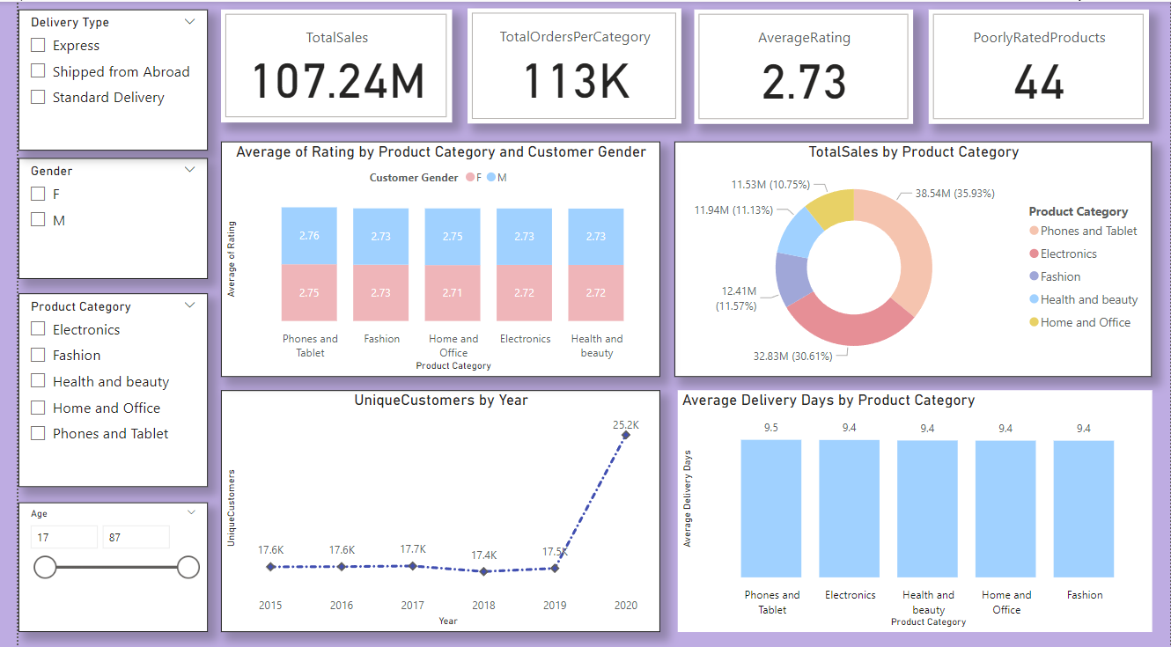
Product Category Analysis

Slide 15
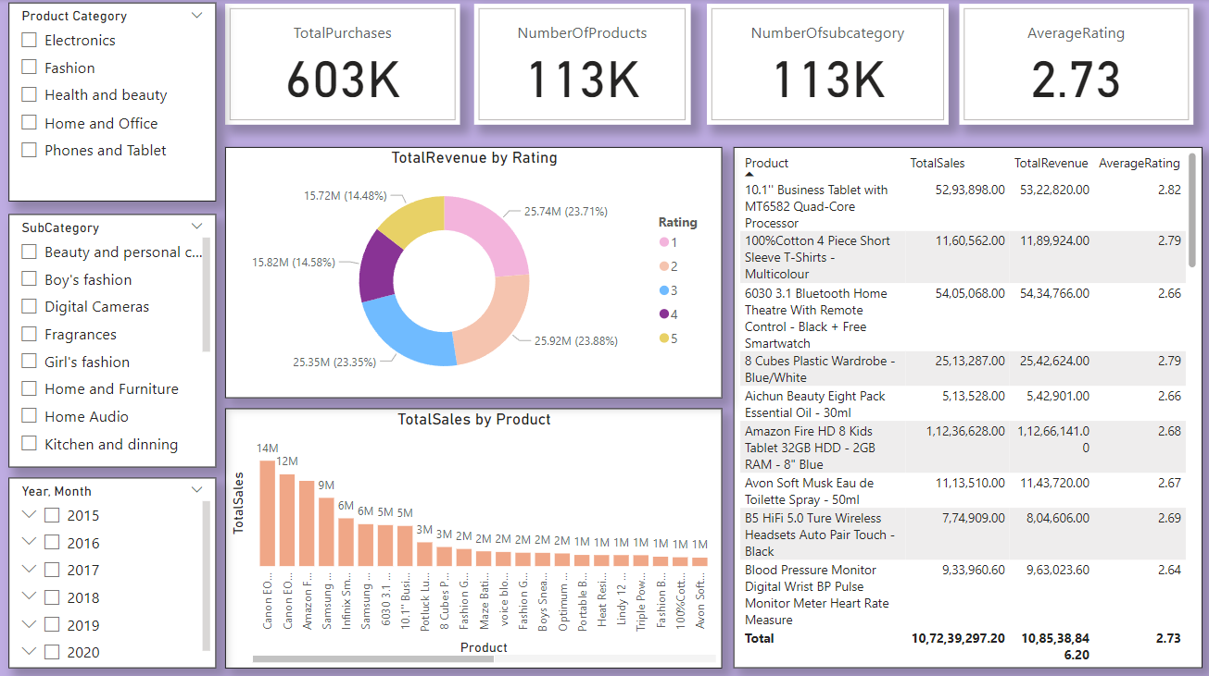
Individual Product Analysis

Slide 16
Thank You

